Slide 1
H1B DATA ANALYSIS USING HADOOP
-Presented By
Priyanka.G
S171169300155

Slide 2

WHAT IS BIG DATA??
Big Data is a new approach to data processing that has two primary components -
1) How data is stored and
2) How data is analysed.

Slide 3
GUIDE TO BIG DATA
Collect everything instead of only a few things. In the past we were extremely limited in what data we could capture and store about any particular event, whether it was a census, an earthquake, or a weather pattern. Advances in storage technology enable Big Data to pull in vast quantities of data and store it for analysis.
Let the data guide the questions, instead of the questions guiding the data. In the past we’ve always started with questions in our minds, and we’ve gathered data to try to answer them. With Big Data we often reverse that process by letting the data speak for itself, which allows us to see patterns that guide the formulation of more intelligent questions.

Slide 4
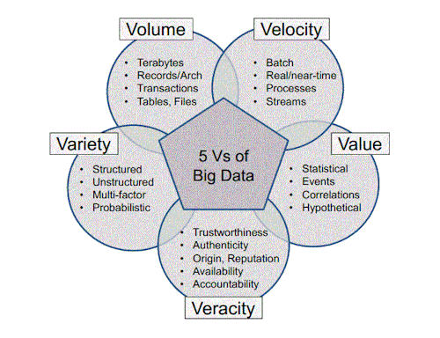
Characteristics of BIG DATA

Slide 5
Characteristics of Big Data
Volume- Big data implies enormous volumes of data.
Variety- Variety refers to the many sources and types of data both structured and unstructured
Veracity- Big Data Veracity refers to the biases, noise and abnormality in data.
Value- Refers to purpose,scenario or business outcome that the analytical solution has to address
Velocity- Big Data Velocity deals with the pace at which data flows in from sources . The flow of data is massive and continuous.

Slide 6

WHAT IS HADOOP?
Hadoop is an open-source framework that was created to make it easier to work with big data
It provides a method to access data, process the data, and manage resources across the computing and network resources that are involved.

Slide 7
How is Hadoop related to big data?
Big data is becoming a catchall phrase, while Hadoop refers to a specific technology framework.
Hadoop is a gateway that makes it possible to work with big data, or more specifically, large data sets that reside in a distributed environment.
One way to define big data is data that is too big to be processed by relational database management systems (RDBMS). Hadoop helps overcome RDBMS limitations, so big data can be processed.

Slide 8
ADVANTAGES AND DISADVANTAGES OF HADOOP
ADVANTAGES
Advanced data analysis can be done in-house
Organizations can fully leverage their data
Run a commodity vs. custom architecture
DISADVANTAGES
Storage requirements
Limited SQL support
Limited native security
Component limitations

Slide 9
HADOOP MODULES
Because it is a framework, Hadoop is not a single technology or product. Instead, Hadoop is made up of four core modules that are supported by a large ecosystem of supporting technologies and products. The modules are:
Hadoop Distributed File System (HDFS) – Provides access to application data.
Hadoop YARN – Provides the framework to schedule jobs and manage resources across the cluster that holds the data
Hadoop MapReduce – A YARN-based parallel processing system for large data sets.
Hadoop Common – A set of utilities that supports the three other core modules.

Slide 10
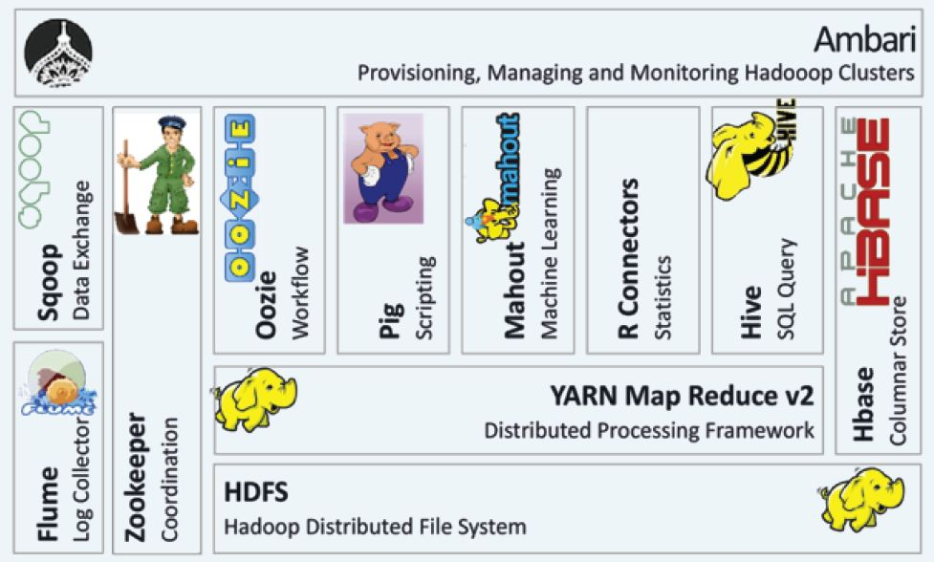
HADOOP ECOSYSTEM

Slide 11
MAP REDUCE
What is MapReduce?
Map/Reduce
MapReduce is the heart of Apache Hadoop. It is this programming paradigm that allows for massive scalability across hundreds or thousands of servers in a Hadoop cluster.
The term MapReduce actually refers to two separate and distinct tasks that Hadoop programs perform. The first is the map job,second is reduce job.
Map job takes a set of data and converts it into another set of data, where individual elements are broken down into tuples (key/value pairs)
Reduce job takes the output from a map as input and combines those data tuples into a smaller set of tuples

Slide 12
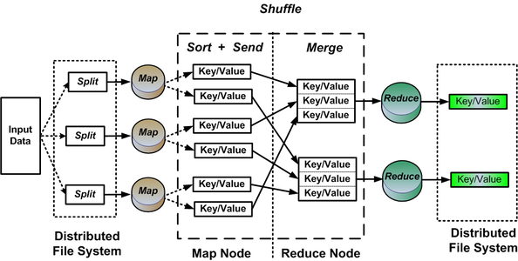

Slide 13

HIVE
Apache Hive is a data ware house system for Hadoop that gives an SQL like interface to query data which internally converts to map reduce jobs.
Hive is also a popular development environment that is used to write queries for data in the Hadoop environment.
It supports Data definition Language, Data Manipulation Language and user defined functions.

Slide 14

PIG
Pig is a procedural language for developing parallel processing applications for large data sets in the Hadoop environment.
Pig is an alternative to Java programming for MapReduce, and automatically generates MapReduce functions.
Pig includes Pig Latin, which is a scripting language. Pig translates Pig Latin scripts into MapReduce, which can then run on YARN and process data in the HDFS cluster.
Pig is commonly used for complex use cases that require multiple data operations. It is more of a processing language than a query language.

Slide 15

SQOOP
Think of Sqoop as a front-end loader for big data. Sqoop is a command-line interface that facilitates moving bulk data from Hadoop into relational databases and other structured data stores.
Using Sqoop replaces the need to develop scripts to export and import data.
One common use case is to move data from an enterprise data warehouse to a Hadoop cluster for ETL (Extract Transport Load)processing

Slide 16


OOZIE AND ZOOKEEPER
Oozie is the workflow scheduler that was developed as part of the Apache Hadoop project. It manages how workflows start and execute, and also controls the execution path.
Zookeeper is a high-performance coordination service for distributed applications.

Slide 17
CONCLUSION
Hadoop has been very effective solution for companies dealing with huge amounts of data. As it is open source, so it is adopted by companies widely
MapReduce code in java makes the complex analysis quite easy. Code Required to be written to collect user input and performing complex join operations are handled efficiently by using this approach.
Hive helps in the cleaning up of the data. csv data can be easily converted into text format using hive.
For normal group by join and filter based data retrieval, pig is very efficient
Sqoop is useful when we have data in sql tables that need to be imported in the hadoop file system.

